Slide 1
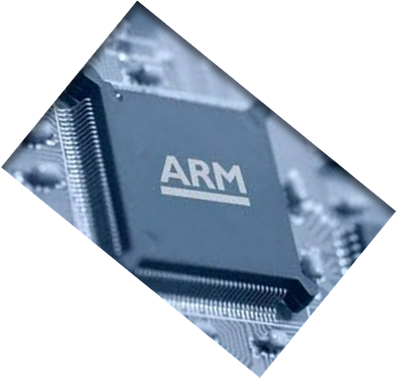
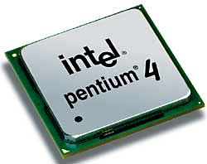
MICROPROCESSOR AND COMPUTER ARCHITECTURE
CACHE
OPTIMIZATION
Credits:
MPCA Team

Slide 2
Cache Optimization
Sixth optimization:
Avoiding Address Translation during Indexing of the Cache to Reduce Hit Time.

Slide 3
Sixth Optimization: Avoiding Address Translation during indexing of the Cache to Reduce Hit Time
Memory Management module of Operating System.
Cache must cope with the translation of a virtual address to physical address to access memory.
Since, processor treats main memory as just another memory in hierarchy, the address of the virtual memory that exists on the disk must be mapped on to the main memory.

Slide 4
Sixth Optimization: Avoiding Address Translation during indexing of the Cache to Reduce Hit Time
Guidelines for cache:
  Virtual addresses are used.
  Hits are common than Misses.
These caches are called Virtual Caches.

Slide 5
Sixth Optimization: Avoiding Address Translation during indexing of the Cache to Reduce Hit Time
Two Tasks:
  Indexing the cache.
  Comparing Addresses.
    A virtual or physical address is used
      To index the cache
      In tag Comparison.
  Virtual addressing for both indexing & tags eliminates address translation time from cache hit.

Slide 6
Sixth Optimization: Avoiding Address Translation during indexing of the Cache to Reduce Hit Time
NOTE: Why doesn’t everyone build virtually addressed cache?
Reason 1 : Protection: page level protection is checked as a part of physical address translation.
Solution : To copy the protection information from TLB on a miss, add a field to hold it, and check it on every access to the virtually addressed cache
Reason 2 : Every time a process is switched, the virtual address refer to the different physical address, requiring the cache to be flushed
Solution: To increase the width of the cache address tag with process identifier tag (PID).

Slide 7
Sixth Optimization: Avoiding Address Translation during indexing of the Cache to Reduce Hit Time
If OS assigns these tags to processes, it will need flush the cache when PID is recycled: i.e., PID distinguishes whether or not the data in the cache are for this program. Thus, shows improvements in miss rates by using PIDs to avoid cache flushes.
Address translations are kept in a special cache.
A memory access rarely requires a second access to translate the data.
This special address translation is referred to as a translation lookaside buffer (TLB) also called Translation buffer(TB).

Slide 8
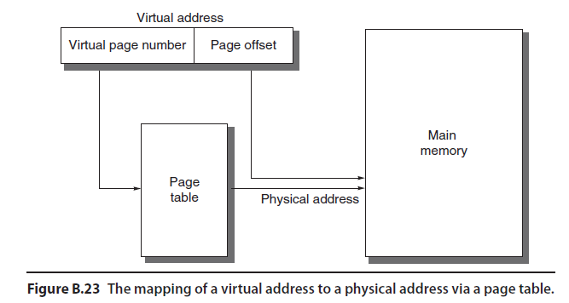
Virtual Address to Physical Address

Slide 9
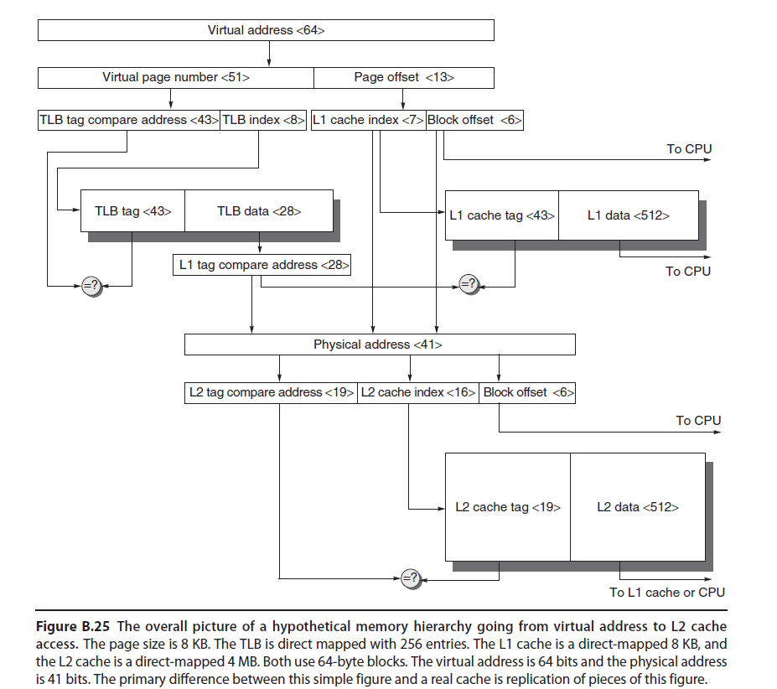
Virtual Address to
Physical Address
64 bit virtual address logically divided into Virtual Page Number & Page Offset.
Virtual page number sent to TLB to translate to physical address.
Page number sent to L1 cache to act as index.
If TLB match is a hit, physical page number is sent to L1 cache tag to check for the match.
If it matches it is a hit in L1 cache.
The block offset then selects the word for the processor.

Slide 10
Translation Lookaside
Buffer - TLB
If L1 cache check is a miss, the physical address is then used to try the L2 cache.
The middle portion the physical address is then used as an index.
The resulting L2 cache tag is compared
to the upper part of the physical
address to check for the match.
  If matches, it is a L2 cache hit.
  Data is sent to the processor.
  The block offset then selects the word for the processor.
On a miss, the physical address is
then used to get the block from the
memory.

Slide 11
Translation Lookaside
Buffer - TLB
First Simplification:
L1 cache is Split cache, It requires, two TLBs.
One cache & TLB is for
instructions.
  Driven from the PC.
One cache & TLB is for Data.
  Driven from the effective address.

Slide 12
Translation Lookaside
Buffer - TLB
Second Simplification:
  All caches and TLBs are direct mapped.
  If associativity is used it would replicate each set of comparators, tag memory and data memory.
  Connect data memories with a n:1 MUX to select a hit.
  If total cache size remained the same, the cache index would also shrink by log2n bits.

Slide 13
Q & A
Six Basic Cache
Optimizations

